Slide 1
ABS cohort model specification and walk through [draft]
January 2024
Will Walker

Slide 2
Content
1.1 Model specification
1.2 Methodology overview
1.3 model map
2. Assumptions
3. Data sources
5. Demographic adjustment
6. Estimating and adjusting learner prior attainment
7. Simulating ABS maths and English routes
8. Simulating ABS pathway choices
9. Assigning learners to provider types
10. Attaching GLH to learners' routes and pathways
11. Estimating the relative volume of teaching
12. How can this model be expanded?
13. Glossary

Slide 3
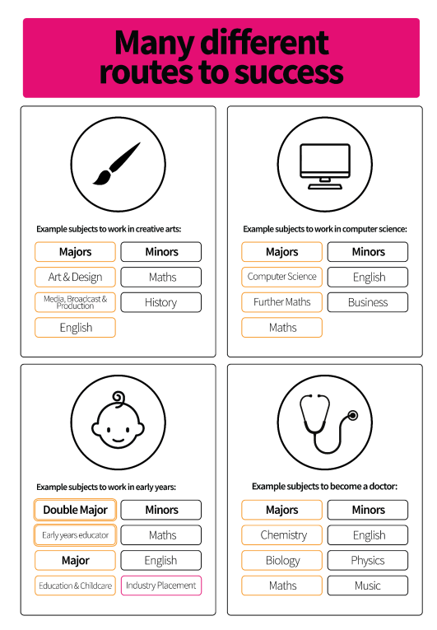
1.1 What this model does
This model is a micro simulation in R; based on the characteristics of the 2018/19 cohort (prior attainment), we have predicted which pathways these individual learners might have taken under ABS in 2033/34.
The model adjusts this cohort to fit with the predicted characteristics and size etc. of the cohort in 2033/34.
This model includes assumptions about the GLH of learners KS5 pathway’s relative to choices under the current system.
This model predicts the relative volume of reaching required under ABS
The model at present is a basic prototype which has been built so it can be expanded/ to accommodate a wide range of analytical and policy assumptions about the shape and nature of ABS. (options are set out in section 12)
The granularity means we can assess the implications of ABS by a wide range of pupil/provider level characteristic (including by geography etc.).

Slide 4
Model inputs and outputs
Inputs
Data
YPMAD 2018/19 cohort characteristics and attainment
ONS population projections
Assumptions (full list in section 2)
Design of the ABS – what options are available? what are the GLH?
Learners' behavioural response to ABS – what pathways and maths and english routes will they choose? Subject to attainment.
Outputs
We estimate the likely Maths and English route, overall pathway, location, institution and characteristics of every simulated member of the 2033/34 ABS cohort. This currently takes no account of real-world constraints
Via the GLH attached to the subject routes and pathways chosen by each learner we can estimate the relative volume of teaching required compared to 2018/19. This is a unitless measure e.g. 10% more teaching.

Slide 5
1.2 Methodology overview
Cohort model
The model takes YPMAD data on the 18/19 KS5 cohort. Subject to the following adjustments, we assume the 2033/34 cohort will have similar characterises to this historic cohort.
Specific English and Maths attainment (UMS) is generated (I don’t have exact marks in my dataset) and then adjusted to account for improving attainment by 2033.
A demographic adjustment is made by counting each learner as 1 x (expected growth in pupil numbers from 2018/19 – 2033/34) FTE. To avoid double counting workforce implications with the current shortfall, these initial models do not use the demographically adjusted numbers.
For each learner, based on prior attainment in KS4 Math and Eng we apply assumptions about the distribution of ABS Maths/Eng routes they will respectively choose. Since this is a micro simulation, we roll the dice once to determine which routes individuals choose in this simulation. For the overall ABS pathway, we work out thresholds for each pathway based on the average distribution according to Math and English prior attainment, dice are the rolled against each individual’s aggregated threshold to determine this learners’ likely pathway.
[Given the learners chosen ABS pathway, roll dice to determine the type of institution they attend] (this strand of analysis is the alternative option to assuming provision is delivered In the same/analogous setting to the 2018/19 YPMAD cohort)
Relative volume of teaching
Quantify current requirements by applying assumptions about the GLH of the current KS5 study programmes plus Maths and English study; to compare with the future estimate by applying assumption on the GLH of ABS pathways and maths and English routes. Have sought to standardise output into “teaching units” (TU) where 1 unit is equivalent to the GLH of a legacy A level.
Aggregate the relative GLH teaching units (“volume of teaching”) under ABS compared to legacy KS5.

Slide 6
1.3 Model map
ABS cohort model
7.2 Maths ABS route
10. Attach GLH to ABS route/pathway compared to current routes.
6. Adjusted KS4 maths
2. Individual learners, 2018/19
5. Demographic adjustment
6. Attainment adjustment
7.1 English ABS route
6. Adjusted KS4 English
8. ABS pathway
(9. Institution type)
Change in required volume of teaching
11. Aggregate ABS pathway GLH units
11. Required additional volume of teaching
11. Aggregate legacy pathway GLH units
11. How much of the additional teaching is Eng/Maths?
11. Aggregate legacy Maths/Eng GLH units
11. Required additional volume of Maths/Eng teaching
11. Aggregate ABS Maths/Eng GLH units

Slide 7
2. Assumptions
Assumption | Baseline values | Section in this documentation | Certainty | Sensitivity | Potential range
The 2018/19 KS5 cohort closely resembles the ABS cohort in 2033/34 | This model estimates what pathway the 2018/19 cohort would have taken if ABS had existed. The only adjustments relate to changes in attainment and population | 2. Assumptions | High | Low | ?? Characteristics like SEN and Ethnicity could be different in 2033/34 etc.
Design of the ABS (L2.5 etc) | Pathway Options are 3 majors and 3 minors; and (all with same GLH) 2 major 3 minor, vocational double major, and L2/below L2 ABS. Maths and English are compulsory and have routes: Major, Minor, GCSE resit, Below L2 and subject for life. | 2. Assumptions | Mid | High | L2.5 option for compulsory maths and English, other routers et
Behavioural response of learners (what will learners choose under ABS compared to the current system?) | Our starting assumptions about the choices learners will take under ABS are that they will choose as similar route to choices taken under the legacy system, subject to the constraints placed upon learners under ABS. The constraints are the nature of available routes, and compulsory English and Maths. Since this is a Montecarlo micro simulation, the ‘choice’ of each leaner is driven by a probability distribution based on their prior attainment. These distribution are described in sections 7-9. | 7. Simulating ABS maths and English routes, 8. Simulating ABS pathway choices 9. Assigning learners to provider types | Low | High | ?? Any values describing alternative learner behaviours can form the basis of additional scenarios.
Changes in attainment between now and 2033 | No further progress towards 90% Math/English GCSE target. | 6. Estimating and adjusting learner prior attainment | Low | High | 80% pass rate, and 90% pass rate by 2033?
Demographics | 2033/34 cohort is xx% larger than the 2023/24 cohort. | 5. Demographic adjustment | High | low | N/A, Demographic changes are highly certain for this cohort
Workforce assumptions (subject GLH) | Most ABS routes require 20% more teaching. ABS Major has 90% GLH of an A level course, ABS minors have 45% GLH of an A level course. | 10. Attaching GLH to learners' routes and pathways | Mid | High | ?? The GLH of each route can be set to any values.
Apprenticeship take-up | Apprenticeship take-up remains around 5% (no progress toward the 40% target). | 8. Simulating ABS pathway choices | Low | High | ?? Apprenticeship take up can be set to any values.

Slide 8
3. Data
Data | Source | Dependent assumptions
YPMAD Cohort | YPMAD cohort academic age 16 in 2018/19 | The 2018/19 KS5 cohort closely resembles the ABS cohort in 2033/34
YPMAD maths and English continuation | YPMAD maths and English attainment by age 15, and recorded maths /English level of study at age 16. | Behavioural response of learners (what will learners choose under ABS compared to the current system?)
YPMAD KS5 pathways | YPMAD grouped qual at age 16 | Behavioural response of learners (what will learners choose under ABS compared to the current system?)
YPMAD institutions | YPMAD grouped institution type | Behavioural response of learners (what will learners choose under ABS compared to the current system?)
Characteristics of those studying 4 or more subjects | PDR 2007-2010 cohort (will be updated!) | Prior attainment distribution of candidates choosing 3 majors and 3 minors compared to 2 majors and 3 minors.
16-19 population | ONS 2020 based population projections | Demographic adjustment

Slide 9
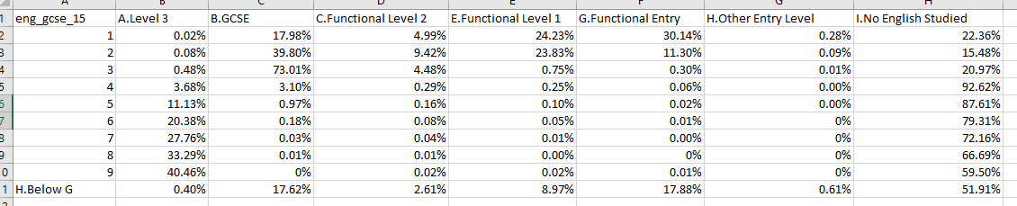
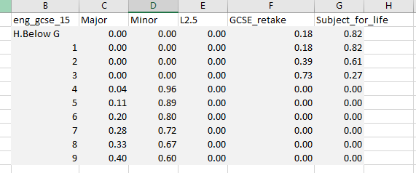
3.1 Data to assumption example
YPMAD 2018/19 English studied at 16 by prior attainment at 15
The distribution above of KS5 English choices are transposed to our assumptions on the right about what people will choose under ABS.
The figures are adjusted to account for constraints under ABS; since English will be compulsory, those who do not currently study it are allocated elsewhere (minor or subject for life depending on prior attainment).

Slide 10
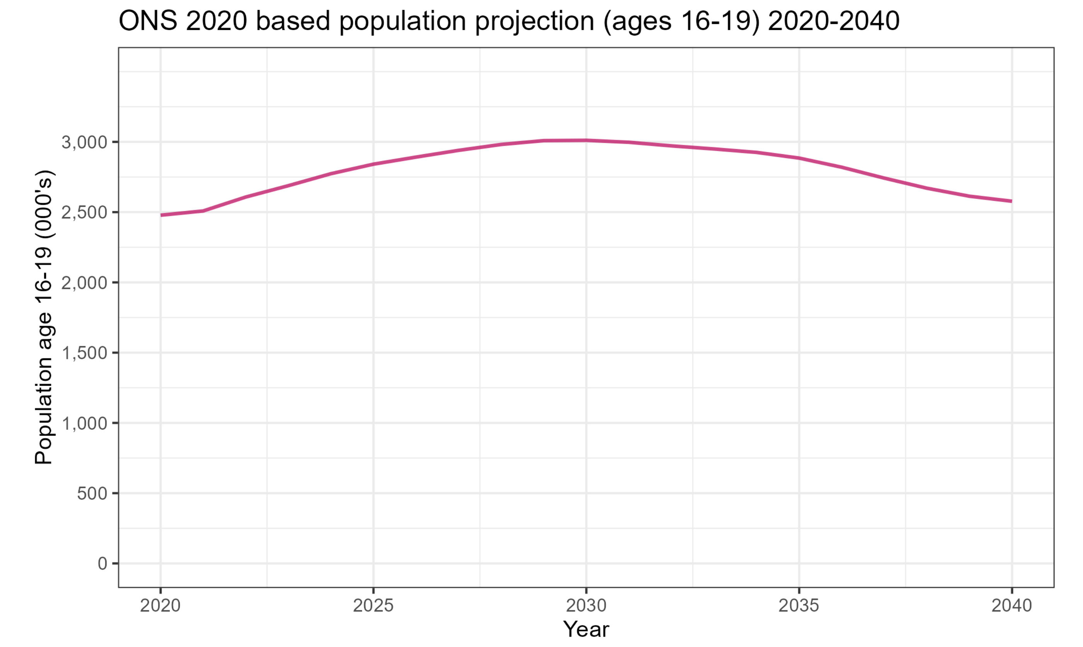
5. Demographic adjustment
The 16-19 population will be different in 2033 to our reference cohort from 2017/18
We add a weighted FTE flag of 1.xx to account for differences in population
This adjusted FTE is not currently used for the additional teaching calculations to avoid double counting workforce implications with the current shortfall. (to discuss!)
To be updated with timeseries from 2018/19.

Slide 11
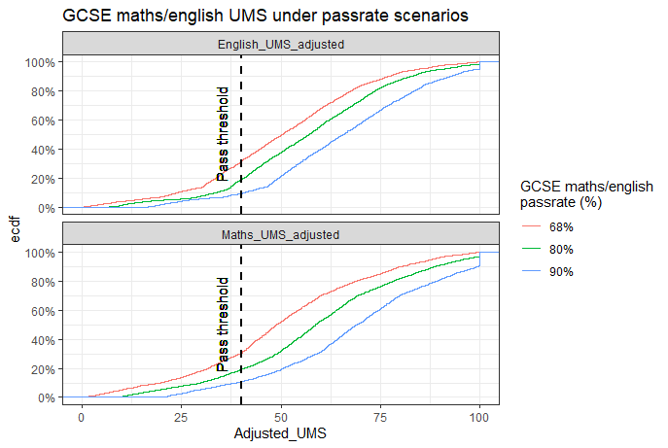
6. Estimating and adjusting learner prior attainment
DfE has a target to improve GCSE English and Maths pass rates to 90% by 2030. This analysis includes scenarios where this is achieved, missed, and no progress made.
Our YPMAD data contains only learners' grades in GCSE maths and English. In order to adjust naturally we need to know how far into each grade every candidate is. Learners are assumed to be evenly distributed within each grade boundary.
The attainment adjustment is made by uplifting all candidates UMS by a fixed value E.g, for 80% pass rates, the maths uplift was 9 UMS, and English uplift was 6.5 UMS.
Learner grades are then reevaluated based on the Adjusted UMS

Slide 12
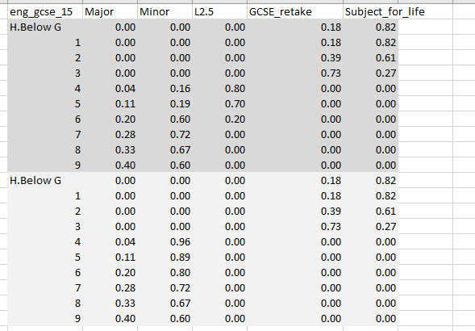
7.1 Simulating ABS maths and English routes
From learners' choices in our 2017/18 YPMAD cohort, we know the distribution of Maths and English routes studied under the legacy KS5 according to a learner’s L2 prior attainment at age 15.
This historical behaviour is the basis of our assumptions about the choices that will be made under ABS.
The main alteration is that everyone who passes GCSE will do at least the minor.
However, since (especially for maths) performance on L3 is poor among those with poorer GCSE grades, I have created a scenario (in the darker grey) with an intermediate “L2.5” option. The assumed proportions on this route are arbitrary for now.
Routes are selected by rolling dice to determine in to which part of the distribution – and hence route - each learner drop.

Slide 13
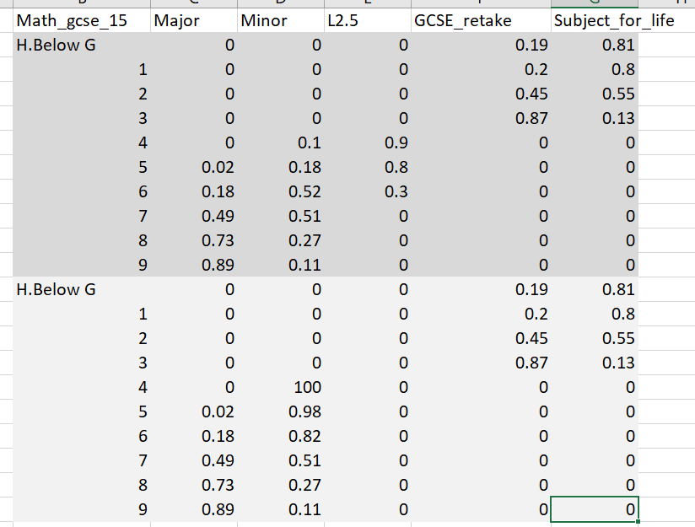
7.2 Simulating ABS maths and English routes (cont.)
Maths behaviour generally requires higher KS4 attainment as a prerequisite for taking the major option under ABS compared to English.

Slide 14
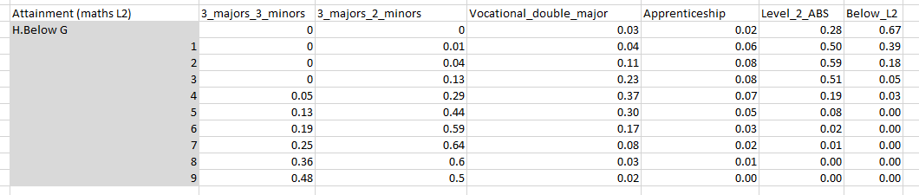
8.1 Simulating ABS pathway choices
Learners chosen pathways under the current system form the basis of our assumptions about the pathways they will select under ABS. Selected pathways are independent from chosen English and Maths routes. There are only a few scenarios where this produces questionable combinations (e.g. double major plus maths major, though few on vocational routes have the prerequisites).
Our analysis takes the average of English and Maths distributions to produce a new probability distribution used when rolling the dice to allocate each learner on an ABS pathway.
The proportion of learners taking 3 majors and 3 minors is taken from the distribution of learners studying 4 A levels in the 2007 to 2010 cohort, 2 majors and 3 minors is the remaining proportion of learners taking A levels in our YPMAD cohort.
Vocational double major is taken from the proportion who do L3 vocational in the current system. Apprenticeships is those taking advanced or L2 apprenticeships in the current system, those doing GCSE resits are assigned to L2 ABS, and those doing Below L2 are assigned to the Below L2.
All figures have been slightly adjusted to redistribute those who do nothing in the current system.

Slide 15
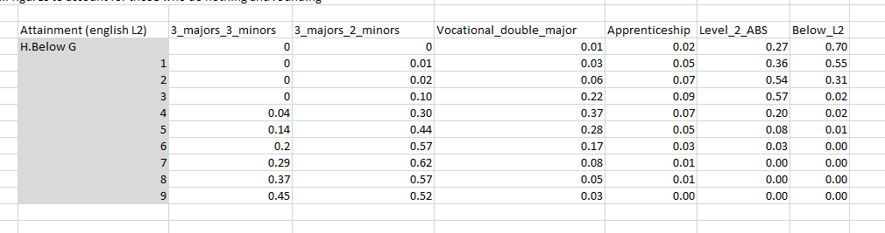
8.2 Simulating ABS pathway choices (cont.)

Slide 16
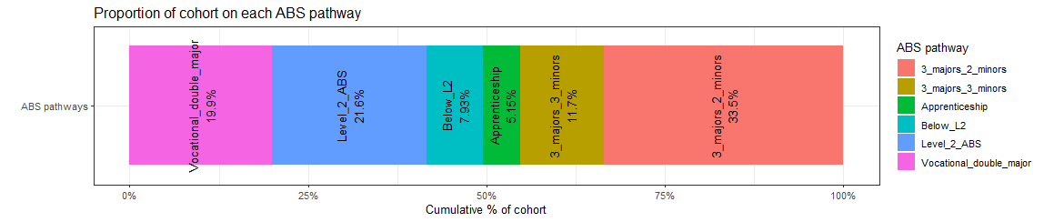
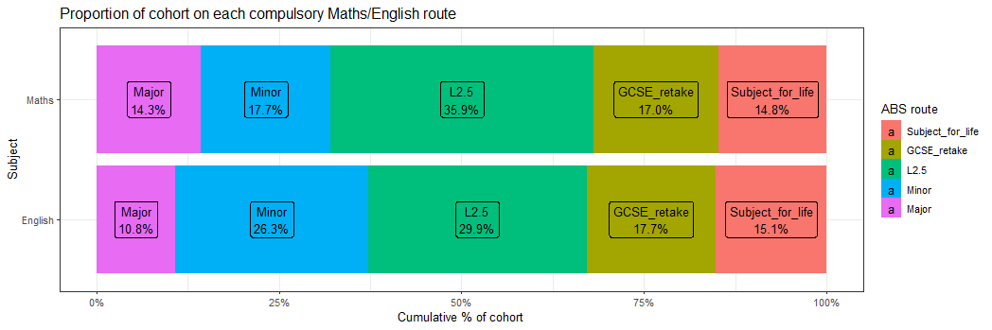
Cohort simulation outputs

Slide 17
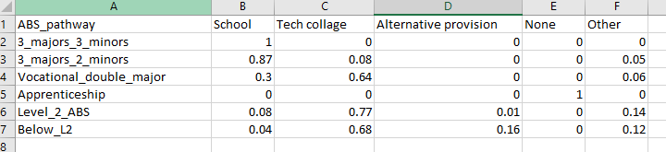
9. Assigning learners to provider types
Further analysis on the provider landscape requires an understanding of the institution learners will attend under ABS in 2033/34.
2033/34 is far in the future so assuming learners will attend the same (or at least analogous) institutions to those attended in the 2017/18 cohort may not be appropriate.
Accordingly, we simulate the type of provider each learners would elect to attend given their ABS pathway choice, and could in future analyse provision maps according to each learners' location, e.g. “We project demand for 3,000 places at FE colleges in Cumberland” etc.
This assumption is created by taking the distribution of provider types by ABS pathway assuming learners attended the same institutions they do under the legacy system.

Slide 18
10.1 Attaching GLH to learners' routes and pathways
In order to estimate the additional volume of teaching required under ABS, we attach a unit of GLH to learners' legacy and ABS pathways, and legacy and ABS Eng/Maths routes.
To standardise, I have not used the actual GLH of A levels and ABS courses, and have instead used “teaching units” (TU’s) where 1 TU is the GLH of an A level course under ABS.
The output of this model is the relative volume of additional teaching, that is not the number of teachers required as that would be the output of the next – as yet unbuilt – phase of the modelling where need to consider class size, working hours, number of classes taught per week, extent of co-teachability, etc.
Assumptions about the legacy GLH of FE courses are not evidence based.
I also assume that schools will not provide additional teaching for learners taking more than 4 A levels under the current system.
Maths/English route | Relative GLH (TU)
A level | 1
Old AS level | 0.5
Major | 0.9
Minor | 0.45
L2.5 | 0.45
GCSE | 0.45
Subject of life | 0.45

Slide 19
10.2 Attaching GLH to learners' routes and pathways (cont.)
ABS route | Legacy equivalent | Relative GLH teaching units
3 majors 3 minors (3x1 + 3x0.5)*90% = 4.05 | 4 A levels 4x1 = 4 | +0.05 (+1.25%)
3 majors 2 minors (3x1 + 2x0.5)*90% = 3.6 | 3 A levels 3x1 = 3 | +0.6 (+20%)
Vocational double major (1x2 + 1x1+ 2x0.5)*90% = 3.6 | Any vocational level 3 (T levels) (???) Assume 1x3 for now | +0.6 (+20%)
L2 ABS, Below L2 (3x1 + 2x0.5)*90% = 3.6 | GCSE’s or L2 vocational (???) Assume 1x3 for now | +0.6 (+20%)
Apprenticeships (out of scope) | Apprenticeships (out of scope) | +0%

Slide 20
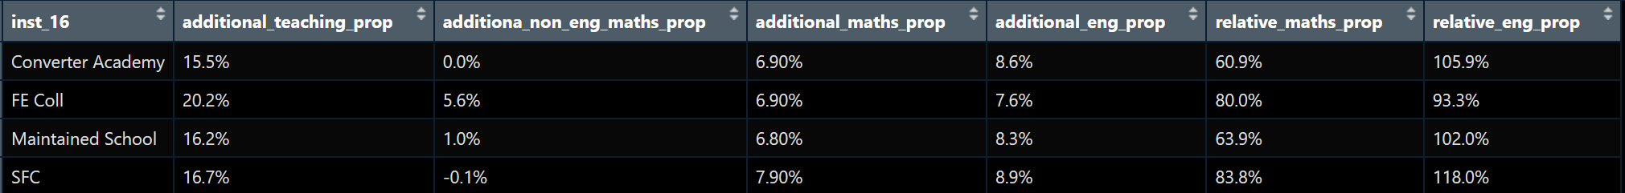
11. Estimating the relative volume of teaching
Evaluating the relative volume of teaching requires aggregating the TU associated with each learners under ABS compared to the legacy system.
We can separately work out the required volume of Eng/Maths teaching by comparing the Eng/Maths TU between the systems.
By combining these two calculations we can further see how much of the additional teaching is comprised of English and maths
Since this is a micro simulation, we can look at these outputs at a wide variety of levels….

Slide 21
12. How can/should this model be expanded? (to discuss)
e.g.
Regional demographic adjustments
Subject choices other than English and maths
More factors to determine each leaner ABS pathway/subject routes
Real world constraints

Slide 22
13. Glossary
Term | Meaning
Route | E.g maths “route” refers to learners' chosen option for Maths and English
Pathway | Refers to the learners chosen overall KS5 option (e.g. “2 majors and 3 minors”/ “A levels”)
Teaching units (TU’s) | The guided learning hours of a whole A level under the current KS5 system.

Slide 23
